Slide 1
Advanced Image Processing Techniques for Medical Diagnostics in Stroke Prediction
PIP2001 Capstone Project
Review-0
Batch Number:12
Under the Supervision of,
Dr./Mr./Ms./Prof. Bhavya.B
Professor / Associate Professor / Assistant Professor
School of Computer Science and Engineering
Presidency University
Roll Number | Student Name
20211CIT0052 | ERANTI SAI KISHAN
20211CIT0060 | MEGHANA.GS
20211CIT0049 | LAKKI REDDY VARSHITHA
20211CIT0053 | ERANTI SAI DINESH
Name of the Program: CSE(IOT)
Name of the HoD: Dr. Anandaraj S P
Name of the Program Project Coordinator: Dr. Sharmasth Vali Y
Name of the School Project Coordinators: Dr. Sampath A K / Dr. Abdul Khadar A / Mr. Md Ziaur Rahman

Slide 2
Problem Statement
Automated Stroke Prediction Using Machine Learning
Importance of Early Detection: Stroke is a major cause of death and disability, making rapid detection and accurate prediction crucial for effective early treatment.
Limitations of Current Methods: Current diagnostic methods like CT scans and MRI rely on expert analysis, which can be time-consuming, especially in emergency situations.
Need for Advanced Systems: There is a need for a real-time system that integrates machine learning, image processing, and clinical data to improve stroke prediction and diagnosis.

Slide 3
Timeline of the Project
Phase | Duration | Milestone
(Phase1) *Planning and Research *Data Collection | 4 weeks | *Defined scope and approach for the project , *Collected and preprocessed data
(Phase 2) *Model Development *Explainability and Validation | 4 weeks | *Built and trained machine learning models and Model explainability achieved, * model validated
(Phase 3) *Web Application Development *Testing and Deployment *Final Evaluation | 4 weeks | *Web-based prediction tool developed, *System tested and deployed , *Project finalized with documentation and evaluation

Slide 4
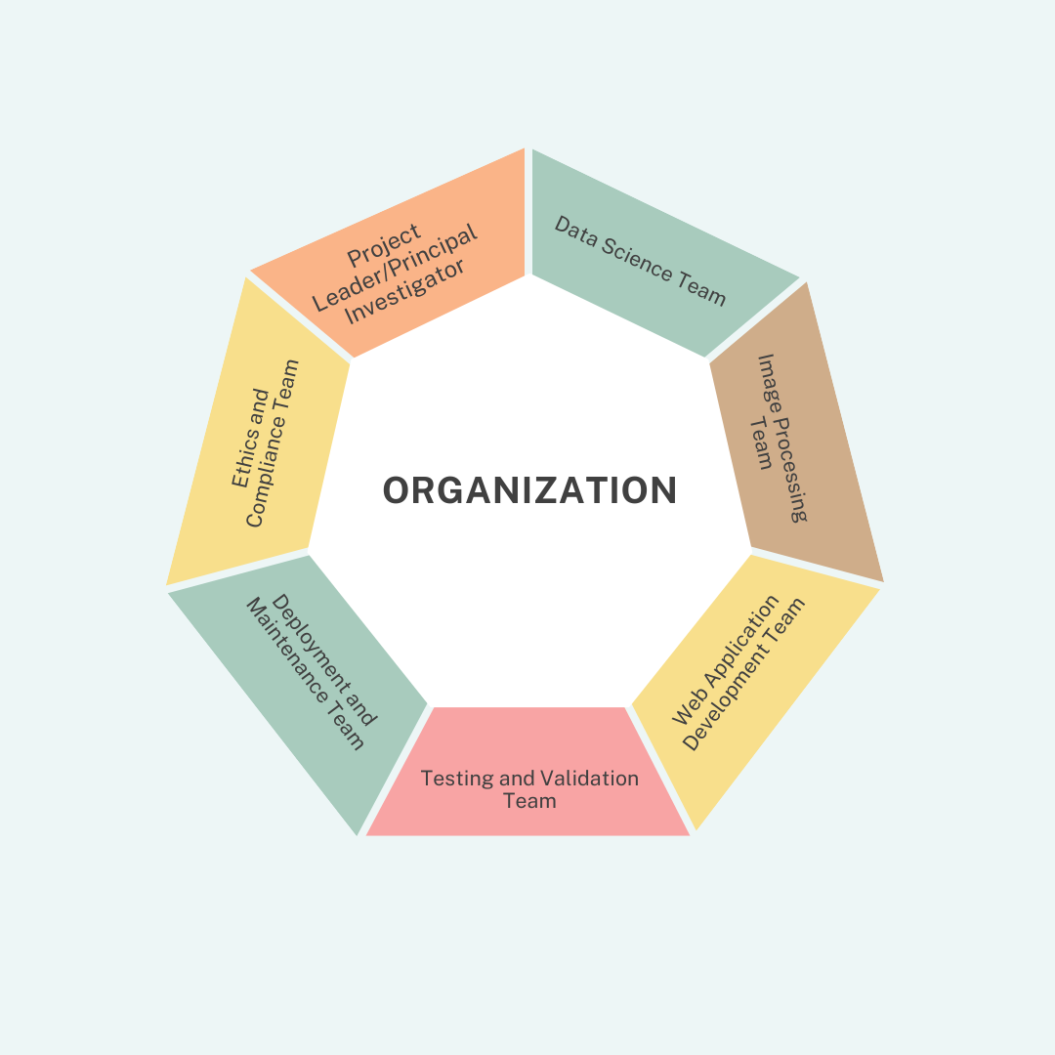
Organization

Slide 5
Organization:
Communication and Reporting Structure
Weekly Team Meetings:
Conduct meetings to ensure progress is aligned with project milestones.
Share updates from each team (Data Science, Image Processing, Web Development).
Monthly Stakeholder Reviews:
Present project progress to stakeholders such as hospitals, clinicians, and potential investors.
Review the project's impact and implementation status.
Documentation:
Maintain comprehensive documentation for machine learning models, image processing techniques, system architecture, and compliance procedures.
Version Control:
Use Git or other version control tools to manage code for the machine learning models, image processing algorithms, and web application development.

Slide 6
Category (Hardware / Software / Both)
Software
* Software Components
Machine Learning Algorithms
Image Processing Techniques
Web Application
Explainability Tools

Slide 7
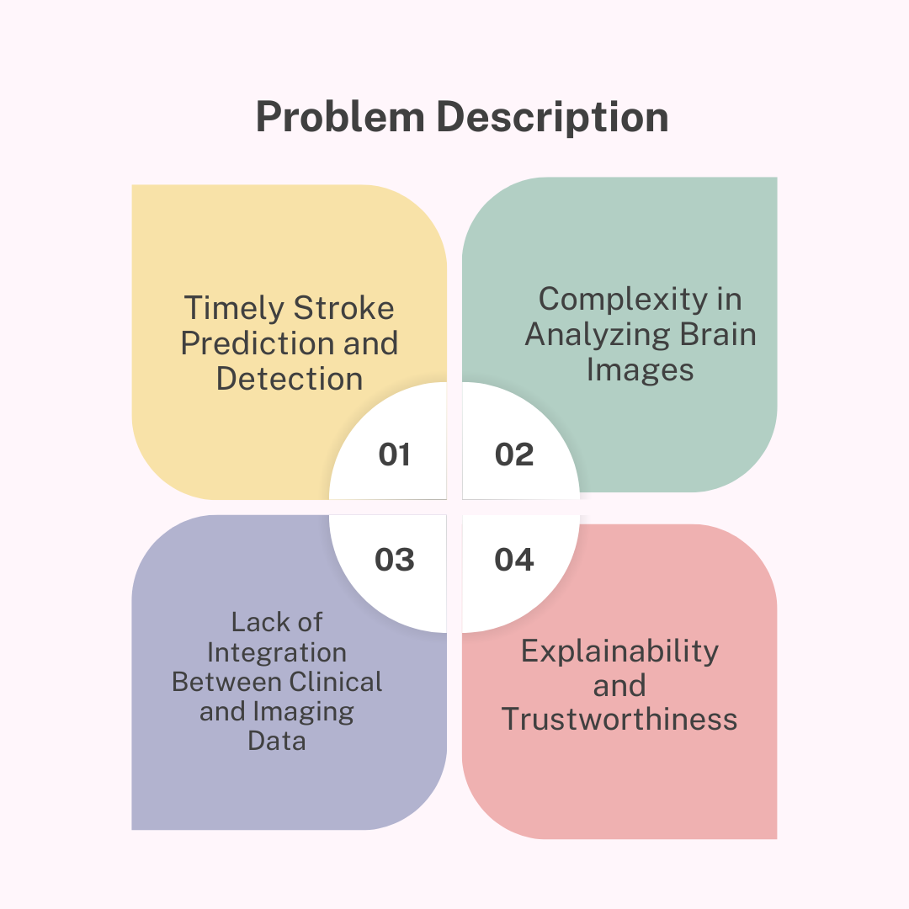
Problem Description

Slide 8
Difficulty Level
Complex
Machine Learning Complexity
Image Processing
Explainability and Interpretability
Healthcare Integration
Given the need for expertise in both machine learning and medical image processing, as well as the challenges related to data integration, explainability, and healthcare compliance, this project would require advanced skills across multiple domains. Thus, the difficulty level is classified as Advanced.

Slide 9
Analysis of Problem Statement
Technology Stack Components:
Programming Languages: Python (for ML models, backend), JavaScript (for frontend).
Frameworks: TensorFlow/PyTorch (for ML), Flask/Django (for web app), React.js/Vue.js (for frontend).
Libraries: Pandas, NumPy, OpenCV, scikit-learn, SHAP, LIME, Grad-CAM.
Databases: PostgreSQL/MySQL, MongoDB.
Cloud Services: AWS/GCP/Azure.
DevOps: Docker, Kubernetes.
Security: OAuth2, JWT, HIPAA compliance.

Slide 10
Analysis of Problem Statement (contd...)
Software and Hardware Requirements:
Software:Python,TensorFlow/PyTorch,Flask/Django,React.js,AWS/GCP/Azure,SHAP/LIME, Docker,PostgreSQL,MongoDB.
Hardware: Multi-core processors, 16-32 GB RAM, SSD storage (500 GB+), NVIDIA GPUs (RTX/Tesla series), high-speed internet.
Security: OAuth2, SSL/TLS, HIPAA compliance.

Slide 11
Timeline of the Project (Gantt Chart)
Phase | Tasks | Duration | Timeline
Research | Problem Understanding, Planning | 1 week | Week 1
Data Preprocessing | Data Collection, EDA | 3 weeks | Week 2 - Week 4
Model Development | Image Processing, CNN Modeling | 2 weeks | Week 5 - Week 6
Training & Eval | Model Training, Validation | 2 weeks | Week 7 - Week 8
Web Dev | UI, Backend, Model Integration | 2 weeks | Week 9 - Week 10
Deployment | Cloud Infra, Model Deployment | 1 week | Week 11
Testing | UAT, Feedback, Optimization | 1 week | Week 12
Maintenance | Ongoing System Updates, Security | Ongoing | Post-Deployment

Slide 12
References (IEEE Paper format)
IEEE Transactions on Medical Imaging: A leading journal in the field of medical image analysis.
IEEE Journal of Biomedical and Health Informatics: Focuses on the intersection of biomedical engineering and informatics.
IEEE Transactions on Biomedical Engineering: Covers a wide range of topics in biomedical engineering, including medical imaging and signal processing.
IEEE International Conference on Engineering in Medicine and Biology (EMBC): A major annual conference in the field of biomedical engineering.
IEEE Conference on Computer Vision and Pattern Recognition (CVPR): A top-tier conference for computer vision research, including medical image analysis.

Slide 13


